Slide 1
AI solution for creating fire detection system. Using smart cameras, you can identify various suspicious incidents such as collisions, medical emergencies, and FIRES. Of such, fire is the most dangerous abnormal occurrence, because failure to control it at an early stage can lead to huge disasters, leading to human, ecological and economic losses.
fire detection SYSTEM:
Ai Solution

Slide 2
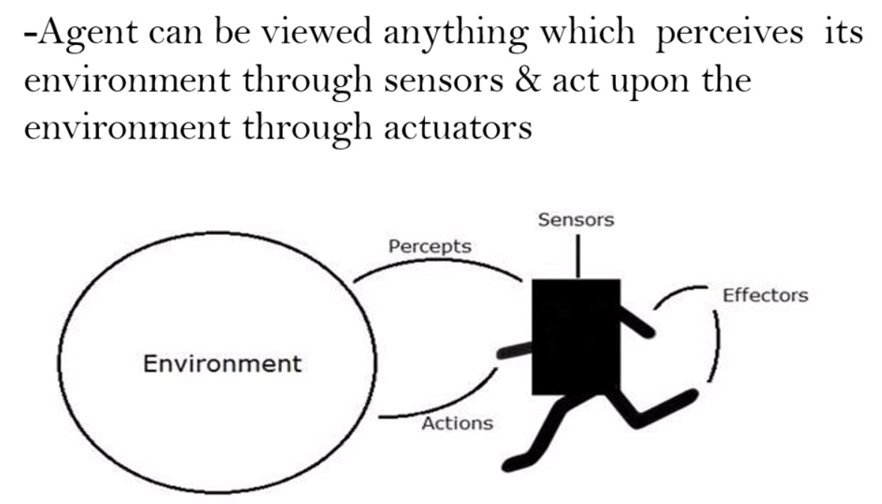
Fire Detection- Ai Agent
Agent can be viewed anything which perceives its environment through Sensors & act upon the environment through actuators
PEAS System: It is used to categorize similar agents together. The PEAS system delivers the performance measure with respect to the environment, actuators and sensors of the respective agent.
P- Performance Measures
The unit to define the success of an agent.
Less Fire Damage
Managing fire disasters on time
E- Task environment
The surrounding of an agent at every instant.
Any habitual places
A- Actuator : Part of the agent that delivers the output of an action
Immediate Alarming System
Online communication channel: Email notification, Sensor lightening
S- Sensor
The receptive parts of an agent which takes in the input for the agent.
Surveillance Cameras

Slide 3




Data Science Component
Collection
Cleaning
Conversion
Fire-Flame-Dataset:
An image dataset for training fire and frame detection AI. It is collected in order to train machine learning model to recognize Fire, smoke, and neutral(images without fire or smoke).This a dataset containing about 3000 images and 3 classes which include:
Fire
Smoke
neutral
There are 1000 images in each category and 900 for train and 100 for testing
We will implement and see its output and limitations and create a customized model. To balance the efficiency and accuracy, the model would be created to fine-tune the nature of the target problem and fire data.

Slide 4
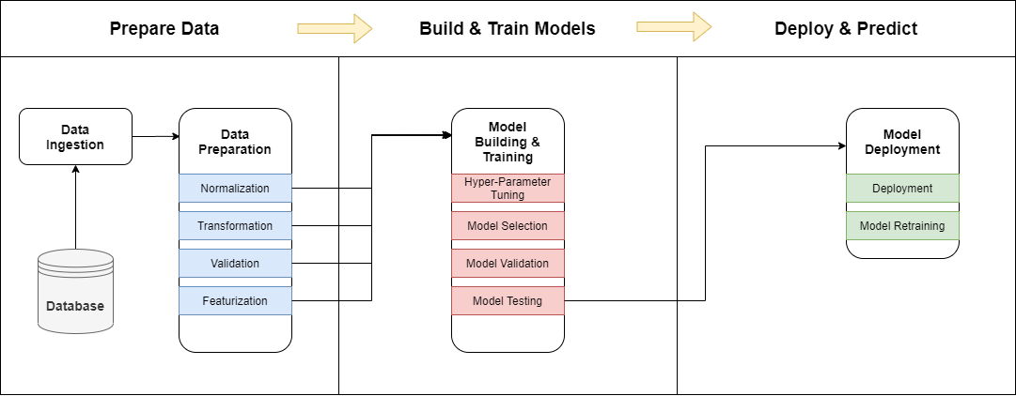
Machine Learning Component
We will train a Deep Learning model for Detection of fire using Python platform.
We will use the TensorFlow, and several libraries required from the KERAS API and libraries.
Inceptionv3 is a convolutional neural network (CNN) for assisting in image analysis. And classification of situation (of Fire in our case) in the world of Computer Vision.

Slide 5
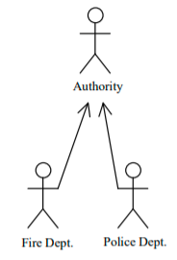
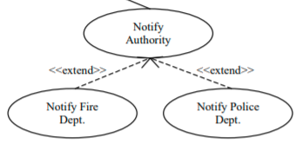
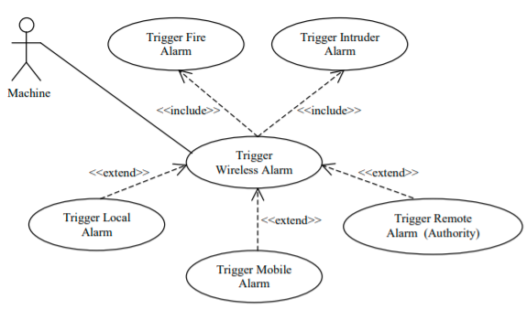
Use Case Scenario
USE CASE
Goal in Context:
The remote webcam will notify the fire department authority of the fire detection (the fire department alarms the respective department after evaluation of the fire detection).
Stakeholders:
Fire Department – wants notification of the fire detection via the remote fire alarm or online communication channel.
Precondition:
Fire detector(s) (wireless cameras integrated with the home security system) are armed and operable via wireless connection
Trigger:
The remote webcam alarms the fire department of the fire detection.

Slide 6
Open Issue
Do the Fire alarms trigger simultaneously or in sequence?
Team Name: Fire Rescuers Product Name: Fire Detection System
Team member | Task needs to be completed
Anurag Sharma (Tech Lead) | Studying the several model training CNN architectures
Gbemisola Banjoko | Working on the Alarm System Scenarios
Kartik Jagdish Sojitra | Dataset Study
Ramon Vilarins | Handling the online communication channels

Slide 7
Conclusion
Inspired by the great potential of Convolutional neural networks (CNNs), we can detect fire from images or videos at an early stage. Considering the fair fire detection accuracy of the CNN model, it can be of assistance to disaster management teams in managing fire disasters on time, thus preventing huge losses.
https://github.com/anuragsharma900/Deep-learning-CV-Fire-Detection.git
THANK
YOU

